Slide 1
Capstone Presentation for Taiwan Customer Default
Amit KULKARNI

Slide 2
Table of Content
Content: 1. Project Team 03. 2. Project Charter 04. 3. Executive Summary 05. 4. Exploratory Data Analysis 06.
5. PCA and Factor Analysis 07.
6. Modelling Approach 08. 7. CART 09. 8. Random Forest 10. 9. Neural Networks 11. 10. XGBoost 12. 11. Bagging 13.
12. Consolidated View 15.
13. Business Insights 16.

Slide 3


Project Team
Project Team:
Project Guide: Mr. Manjunatha GUMMARAJU
About Project Guide: An IIM B and a Great Lakes alumni and a Data Scientist, Mr. Manjunath comes with an in-depth expertise in Data Analytics. He is currently a Consultant working to drive organization wide strategies using data analytics as the tool. He has also worked with leading Blue Chip companies and has proved his mettle out there.
Project Owner: Mr. Amit KULKARNI
About Project Owner: A post graduate in the commerce and banking area and corporate financial analyst, Amit comes with an experience of 15+ years in the field of accounting, reporting and system implementation from the business perspective. Currently he is working as an accounting manager with a leading global Insurance company.

Slide 4
Project Charter
Need for the project: Taiwan bank’s credit card holders’ data has been collated. A total of 30000 customers’ information regarding their payments, repayments etc. are collated. Based on this information the actual customer default has been mapped. This default rate is ~22% and the bank considers it to be high and additionally also has no mechanism to anticipate who will default. No cash collection will lead to liquidity crunch and can put heavy loads on working capital and non-performing assets and statutory ratios required leading to more borrowing. Bank wants to evaluate if Machine Learning can be used to build a predictive modelling technique to avoid last minute rush
Project Y: The project will assist to predict the likelihood of the customer defaulting in the credit card payment next month
Objective: Basis the ‘Y’ of the project, various machine learning techniques to be used to predict the likelihood of the default of the card payment next month
Benefits: Machine Learning model built to predict the default risk with at least 85%* accuracy
Timelines:
1st Project Notes submission: 1st Sept 2019
2nd Project Notes submission: 22nd Sept 2019
3rd Project Notes submission: 13th Sept 2019
Final Presentation: 09th Nov 2019
* A dummy target taken to make the project look realistic

Slide 5
Executive Summary
Basic dimensions of the data viewed. Data has ~30000 rows and ~20 columns with information pertaining to the demographics of the customers like marriage, age education etc. and the historical payment and outstanding amounts with whether the customer defaulted or not
Data cleaning and transformation done like rationalizing the categorical variables, converting them to more meaningful descriptions for exploratory analysis done. Ex. Marriage variable with 0, 1, 2 were transformed to 0 being single, 1 being married and 2 being others etc.
Identify if there are any missing values so as to impute them appropriately but in our case there were no missing values
Exploratory data analysis done to visualize the provided data and to get some insights as well
Unsupervised learning technique like PCA and FA used to check for multi-collinearity amongst independent variables and treat them accordingly
Supervised learning techniques like CART, Random Forest, neural network, logistic regression, XGBoost and Bagging done to arrive at an efficient predictive modelling about the customer’s default pattern
Conclude with relevant findings post model evaluations under various techniques

Slide 6
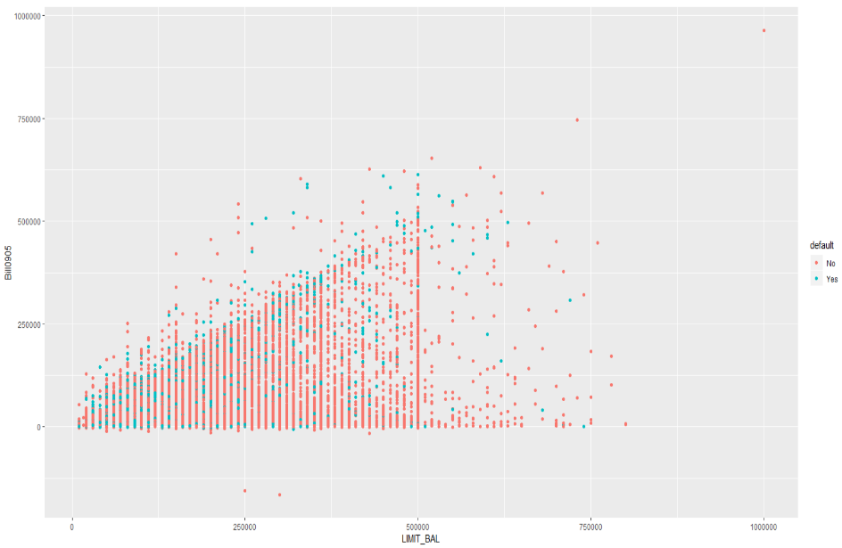
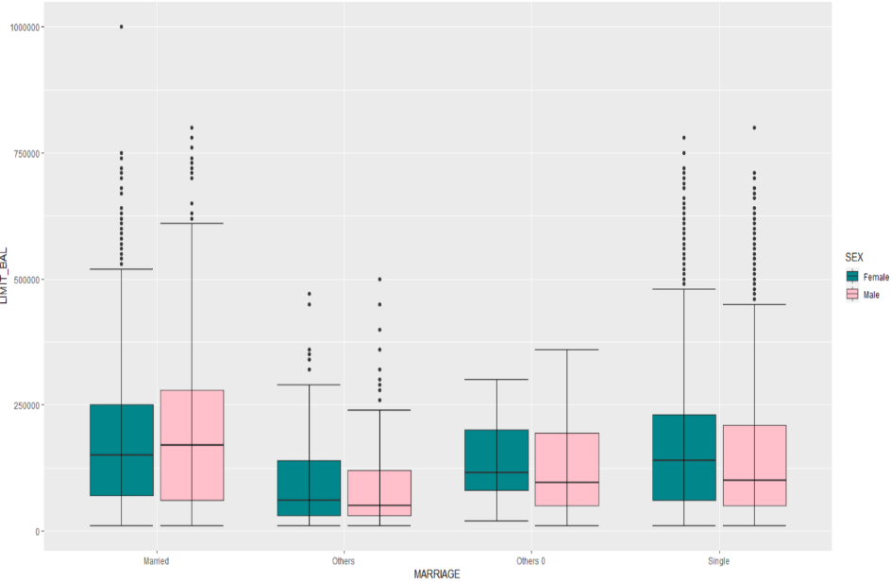
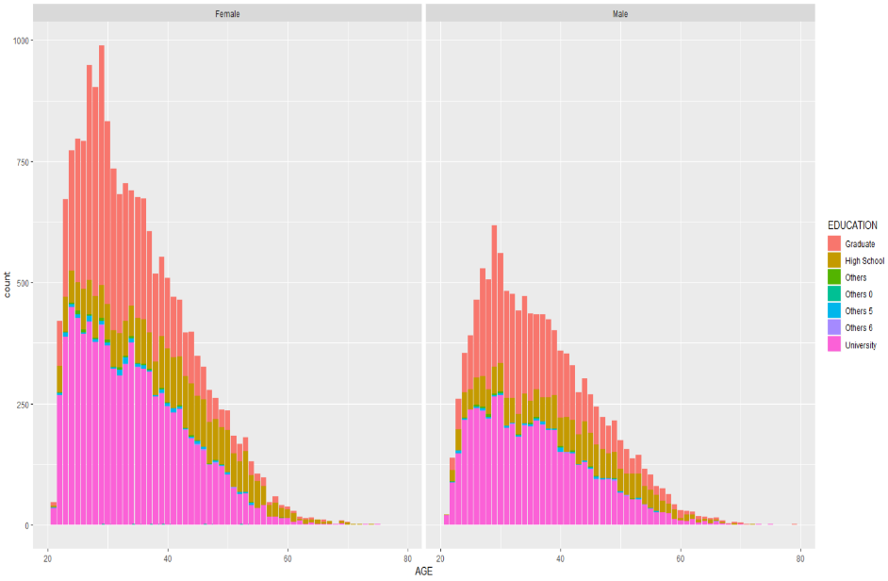
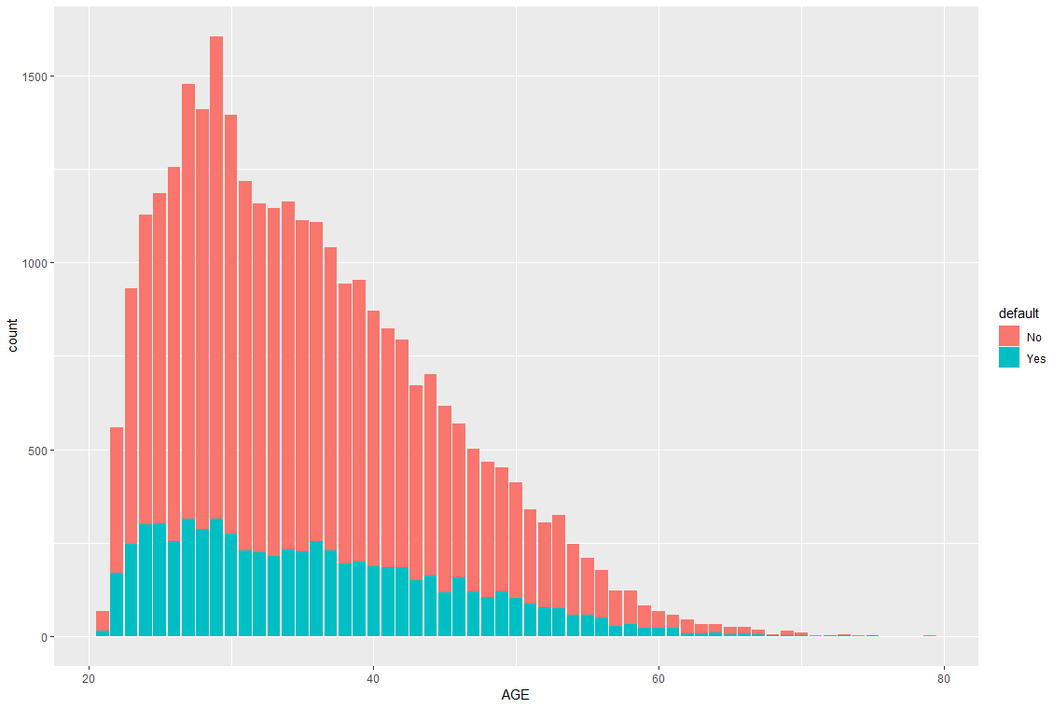
Exploratory Data Analysis
Various demographic variables have been looked at against the default data and the mentioned visualizations have been done
In the scatter plot it is clear that there exists inverse proportion between LIMIT_BALANCE and Billing0905 which simply means that higher the LIMIT_BALANCE lower the billing amount
In the box plot Married males and females have a greater median value of the LIMIT_BALANCE compared to other categories of Single and Others. It depicts that the married customers overall limit balance is high which could mean that their spends on this card is less compared to others in the group
In the histograms, males and females with University as education default the most followed by high school
As far as the age is concerned the defaults seem to be higher between 20-40 meaning as age increases the default chances are reducing

Slide 7
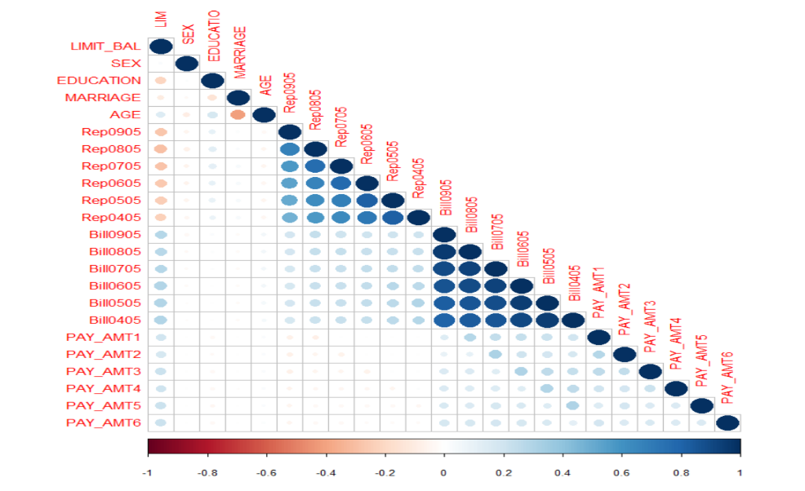
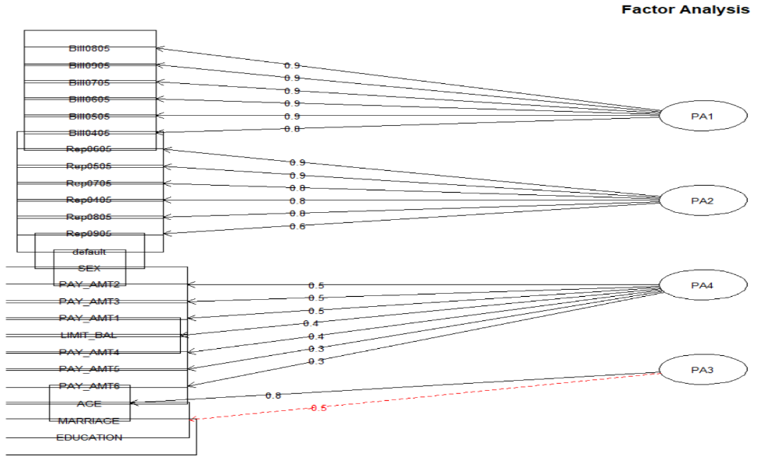
PCA and Factor Analysis
Key Notes:
Weak collinearity can be observed amongst variables except variables which are of similar nature thus existence of collinearity is insignificant
When the Bartlet test was conducted it depicted that there can be a possibility of reduction in the dimensions so factor analysis was performed and dimensions were reduced to 4 variables
Factor Analysis showed that following 4 categories of data can be deduced as a result of dimension reduction. All dimensions are in chronology and follow sequence
Billing
Repayments
Payments
Demographics
However while performing the modelling dimensions are not reduced since the correlation is not significant

Slide 8
Modelling Approach
Problem Statement:
In our problem, the expectation has been defined as looking at the likelihood of the default that a customer can do in paying the credit cards bills
Since we are trying to identify whether the customer the will default or no, we know that we are expecting an output post the model is built. We also know that the expected output is dichotomous in nature so the output is either yes or no
Given the expectation from the problem statement supervised learning techniques will be implemented
Following machine learning techniques are applied like CART, Random Forest, Artificial Neural Network, Logistic Regression, XGBoost, Bagging to test the data set provided
SMOTE technique is not used since the overall default % is ~22% and thus not treated an Unbalanced Data
Data has been divided in to train and test with either 70 and 30 or 80 and 20 percent respectively as has been applied to the Model

Slide 9
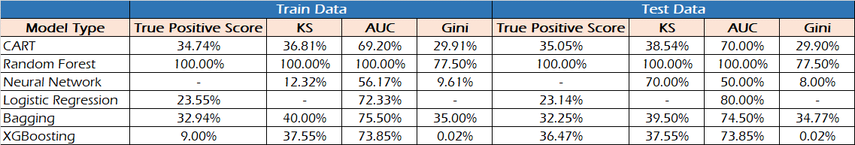
CART
Key Notes:
Necessary steps with rambled tree and subsequently pruned trees were developed in R to test the model.
CART modelling was built for the dataset and the above results were achieved. Model was evaluated through the Confusion Matrix, KS, AUC and Gini.
The Model is fairly fitting since it can observed that the measured values are in the acceptable limits for both Train and Test Data.
However the model is weak since it can be seen that the overall accuracy is not significant in most of the evaluation matrices
The predictive accuracy will be close to 30% which is not significant.
This Model is not recommended or additional information can be sought like the income, dependents etc.

Slide 10
Random Forest
Key Notes:
Necessary steps were taken and the necessary factors considered to build the model in R.
Random Forest modelling was built for the dataset and the above results were achieved. Model was evaluated through the Confusion Matrix, KS, AUC and Gini.
The Model is fairly fitting since it can observed that the measured values are in the acceptable limits for both Train and Test Data.
It can also be observed that the model is strong and significant since under majority of the model evaluation techniques the accuracy is 100%
The business can be cautious to use this model as it is operating at 100%. However it can be re-tested with a new dataset if possible with the same variables
This Model can be further evaluated and considered for building a predictive model for customer defaults

Slide 11
Artificial Neural Network
Key Notes:
Necessary steps were taken and the necessary factors considered to build the model in R.
Neural Networks modelling was built for the dataset and the above results were achieved. Model was evaluated through the KS, AUC and Gini
The Model is overfitting since it can observed that the measured values are not in the acceptable limits for both Train and Test Data
Model is weak and cannot be implemented
If more relevant variables are introduced and analysed it can further be evaluated

Slide 12
Logistic Regression
Key Notes:
Necessary steps were taken and the necessary factors considered to build the model in R.
Logistic Regression modelling was built for the dataset and the above results were achieved. Model was evaluated through the Confusion Matrix and AUC
The Model is fairly fitting since it can observed that the measured values are in the acceptable limits for both Train and Test Data
Model is weak and cannot be implemented.
If more relevant variables are introduced and analysed it can further be evaluated

Slide 13
XGBoost
Key Notes:
Ensemble modelling was done to check if the Model accuracy could be augmented.
Necessary steps were taken and the necessary factors considered to build the model in R.
XGBoost modelling was built for the dataset and the above results were achieved. Model was evaluated through the Confusion Matrix, KS, AUC and Gini methods
The Model is fairly fitting since it can observed that the measured values are in the acceptable limits for both Train and Test Data
However the Model is weak since majority of the evaluation techniques do have lesser %s of accuracy
If more relevant variables are introduced and analysed it can further be evaluated

Slide 14
Bagging
Key Notes:
Ensemble modelling was done to check if the Model accuracy could be augmented.
Necessary steps were taken and the necessary factors considered to build the model in R.
Bagging modelling was built for the dataset and the above results were achieved. Model was evaluated through the Confusion Matrix, KS, AUC and Gini methods
The Model is fairly fitting since it can observed that the measured values are in the acceptable limits for both Train and Test Data
However the Model is weak since majority of the evaluation techniques do have lesser %s of accuracy
If more relevant variables are introduced and analysed it can further be evaluated

Slide 15
Consolidated View
For CART the overall scores for the strength of the model seems weak at ~35% true positive scores and also with KS of ~39% etc. If the comparison of the train to test data is considered, it proves that the model is a right fit as there are no unusual variations amongst the 2
For Random Forest the results seem to be too accurate since it is 100% almost in all measurements and the comparison between the train and test also seems to be the same making the most efficient models in comparison to all models
For Neural Network it’s interesting to see that the model does not seem to be a normal fit. Since the overall variance is ~58%. It can be concluded that the model is not a good fit.
For Logistic Regression True Positive scores are extremely low which means that the model is not able to detect a default as a default. It is may be able to detect a non-defaulter as a non-defaulter which is fair but considering that the business will be more interested to know who is likely to default. In such a business condition the model is falling short and is able to identify only ~24% of the times. The model though is a good fit since the measurement values between train and test do not vary much
Using the bagging and boosting technique as well the model performance did not seem to improve much as the True positives or KS or AUC etc. did not improve as compared to the models

Slide 16
Business Insights
Key Insights:
All the Models except Random Forest have not performed well with respect to their accuracies making the implementation of the machine learning technique dicey
When the collinearity with the dependent variable was done the overall R-squared values did not excel 30%. This meant that the variables considered were not significantly driving the dependent variable. This will mean that more variables like income, dependents, number of earners and other obligations can also be analyzed.
Overall Random Forest did perform well but business should use it cautiously since it provided a score of 100% which is a possibility of overfitting and second it is a black box technique and no much visibility is available of the treatment of the data. Additional values for the same parameters can be re-tested and if the results are encouraging then it can be implemented
Business should re-visit the data collation variables and re-perform the applicability of the Machine Learning Technique

Slide 17

Questions!!!

Slide 18


